Slide 1
How to control which Member Institutions can import records into the Network Zone using import profiles
Yoel Kortick
Senior Librarian

Slide 2

Agenda
Introduction
The configuration to restrict import to Network Zone.
Configuring the default for "Use Network Zone“
Forcing Member Institutions to import to the Network Zone
Placement of new records defined in the Metadata Editor
Manually adding a portfolio/physical item/digital representation

Slide 3
Introduction

Slide 4

Demo Environment Network Zone Consortia
Our sample Network Zone consortia for this presentation
Network Zone institution
Member Institution
‘Alma University’
Member Institution
‘Open University’
Member Institution
‘University of Knowledge’

Slide 5
Introduction
In addition to this presentation, it is recommended to also see Selecting Where to Create New Bibliographic Records which is part of Network-Managed Records in a Network Zone

Slide 6
Introduction
Imported records from the Institution Zone can be imported either to the Member Institution repository or to the Network Zone repository.
The Network Zone administrator can configure (in the Network Zone institution) which Member Institutions of the consortia can (and cannot) import records into the Network Zone repository when using import profiles. This is a new feature for May 2024.

Slide 7
Introduction
In addition, it is possible to determine the following (for members which are not restricted from importing to the Network Zone)
If the default will be to import to the Member Institution or to the Network Zone (central_record_management = DEFAULT_INSTITUTION or DEFAULT_NETWORK)
If the member institution will only be allowed to import to the Network Zone (central_record_management = ENFORCE_NETWORK)

Slide 8
Introduction
The table “Restrict Import to Network” defined in the Network Zone influences which Member Institutions can import records into the Network Zone from the Member Institution.
The parameter central_record_management defined in the Member Institution defines in the member institution
  Where by default a bibliographic record will be saved from the Metadata editor
  Where by default a bibliographic record will be saved when manually creating inventory
    DEFAULT_INSTITUTION = by default in the member institution
    DEFAULT_NETWORK = by default in the member institution
    ENFORCE_NETWORK = only in the network

Slide 9
The configuration to restrict import to Network Zone.

Slide 10
The configuration to restrict import to Network Zone.
This relates to import profiles and not to saving bibliographic records in the Metadata editor or where bibliographic records are saved when inventory is manually created.
This configuration is available in the Network Zone institution at Configuration > Resources > Record Import > Restrict Import to Network.

Slide 11
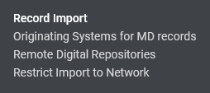
The configuration to restrict import to Network Zone.
Configuration > Resources > Record Import > Restrict Import to Network.

Slide 12
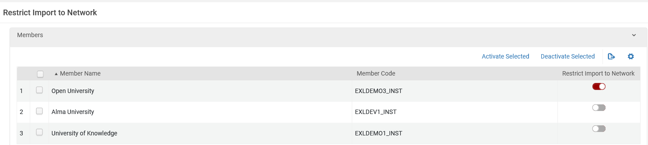
The configuration to restrict import to Network Zone.
In the following setup (which is done in the Network Zone institution) Member Institution Open University cannot import records to the Network Zone.
Member Institutions Alma University and University of Knowledge can import records to the Network Zone.

Slide 13
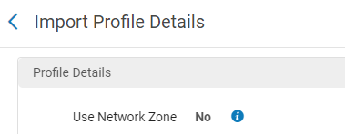
The configuration to restrict import to Network Zone.
Now if a staff user at Member Institution Open University (which we saw is defined as restricted from importing records to the Network Zone) creates a new import profile at “Resources > Import > Manage Import Profiles > Add New Profile” and chooses one of the following profile types: “New Order”, “Update Inventory”, “Repository”, “Digital” or “Collection” then he or she will see the following (which does not include an option to check a box “Use Network Zone”):

Slide 14
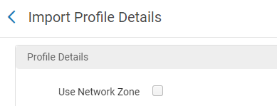
The configuration to restrict import to Network Zone.
However, if a staff user at Member Institution University of Knowledge (which we saw is not defined as restricted from importing records to the Network Zone) creates a new import profile at “Resources > Import > Manage Import Profiles > Add New Profile” then he or she will see the following (which does include an option to check a box “Use Network Zone”):

Slide 15
Configuring the default for "Use Network Zone"

Slide 16
Configuring the default for "Use Network Zone"
When we created the import profile in Member Institution University of Knowledge (which we saw is not defined as restricted from importing records to the Network Zone) we received this option, whereby the checkbox “Use Network Zone” was by default not checked:
by default, not checked

Slide 17
Configuring the default for "Use Network Zone"
The reason this was by default not checked is because the parameter central_record_management was defined in the Member Institution as DEFAULT_INSTITUTION and not DEFAULT_NETWORK.
This parameter is defined within each Member Institution (not centrally from the Network Zone) at “Configuration > Resources > General > Other Settings”.

Slide 18
Configuring the default for "Use Network Zone"
This parameter is only relevant for Member Institutions which are not defined as restricted from importing records to the Network Zone.
This is because if the Member Institution is restricted from importing records to the Network Zone, then it is irrelevant whether “Network Zone” will by default be checked in the import profile, because there is in any case no option to check it when the Member Institution is restricted.

Slide 19
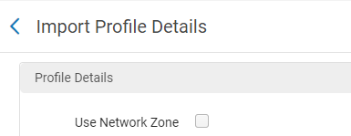
Configuring the default for "Use Network Zone"
Here for example, we see that in Member Institution “University of Knowledge” the parameter central_record_management is defined as DEFAULT_INSTITUTION. Therefore “Use Network Zone” is not by default checked when creating a new import profile.

Slide 20
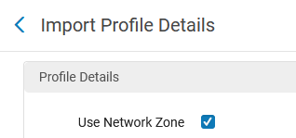
Configuring the default for "Use Network Zone"
Here for example, we see that in Member Institution “Alma University” the parameter central_record_management is defined as DEFAULT_NETWORK. Therefore “Use Network Zone” is by default checked when creating a new import profile.

Slide 21
Forcing Member Institutions to import to the Network Zone

Slide 22
Forcing Member Institutions to import to the Network Zone
Additionally, it is possible to force the Member Institution to import only to the Network Zone.
Note that this parameter is only relevant for Member Institutions which are not defined as restricted from importing records to the Network Zone.
This is because if the Member Institution is restricted from importing records to the Network Zone, then it is irrelevant whether a member is being forced to import to the Network Zone because in any case the Member Institution is not allowed to import to the Network Zone.

Slide 23
Forcing Member Institutions to import to the Network Zone
The relevant parameter for this configuration is central_record_management.
This is the same parameter which we previously saw defined in the Member Institutions examples defined as “DEFAULT INSTITUTION” or “DEFAULT_NETWORK”.
It is also possible to define “ENFORCE_NETWORK”. This means that the only option will be to import to the Network Zone.

Slide 24
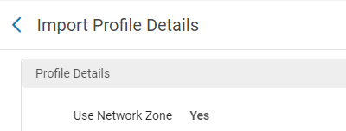
Forcing Member Institutions to import to the Network Zone
Now in Member Institution “University of Knowledge” the parameter central_record_management is defined as “ENFORCE_NETWORK”. As a result, it is possible to import only to the Network Zone via an import profile.
The only option is to import to the Network Zone

Slide 25
Placement of new records defined in the Metadata Editor

Slide 26
Placement of new records defined in the Metadata Editor
The definitions in the Network Zone configuration table “Restrict Import to Network” influence the import profiles (as we saw) but do not influence the placement options defined in the Metadata Editor.
For example, when a Member Institution (for example Open University) is defined in the Network Zone as restricted to import to the Network Zone, but the Member Institution has DEFAULT_NETWORK defined for parameter central_record_management then:
In the Metadata Editor when “New > Placement Options” is accessed the staff user can choose either “Local” or “Network” for “Placement of new records and templates”.

Slide 27
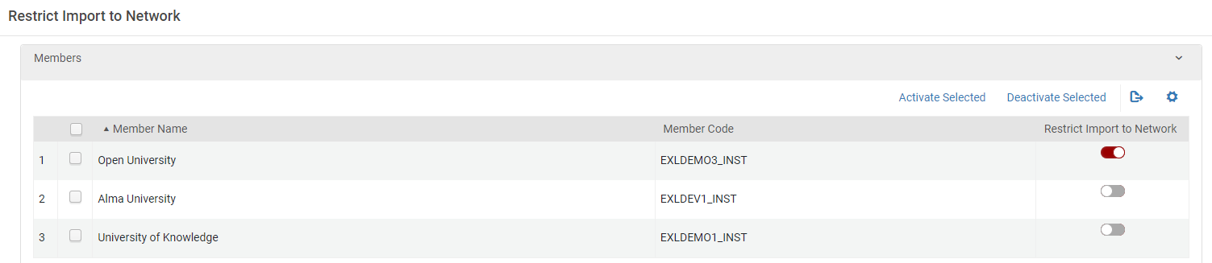
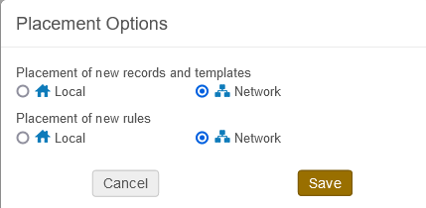
Placement of new records defined in the Metadata Editor
Network Zone configuration for “Restrict Import to Network
“Local” can be chosen for “Placement of new records and templates”
The default option for “Placement of new records and templates” is the Network Zone

Slide 28
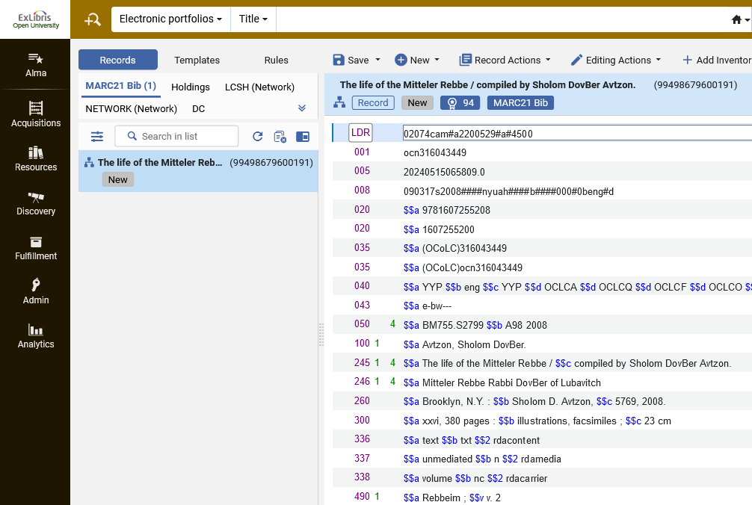
Placement of new records defined in the Metadata Editor
A new record created in the Metadata Editor for Open University is saved in the Network Zone. This is the case even though it is defined in the Network Zone as restricted from importing to the Network Zone.

Slide 29
Placement of new records defined in the Metadata Editor
When a Member Institution (for example University of Knowledge) has central_record_management defined as ENFORCE_NETWORK then:
In the Metadata Editor when “New > Placement Options” is accessed the only option which can be chosen for “Placement of new records and templates” is “Network”

Slide 30
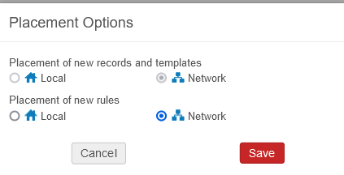
Placement of new records defined in the Metadata Editor
“Local” cannot be chosen for “Placement of new records and templates” (Clicking it does nothing)
The only option for “Placement of new records and templates” is the Network Zone

Slide 31
Manually adding a portfolio/physical item/digital representation

Slide 32
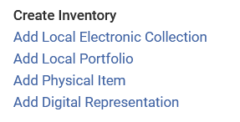
Manually adding a portfolio/physical item/digital representation
A portfolio, physical item or digital representation can be manually added via “Resources > Create Inventory”.
When this happens, a corresponding new bibliographic record gets created (when user chooses “Create New Title” for “Creation Type” .

Slide 33
Manually adding a portfolio/physical item/digital representation
The definitions in the Network Zone configuration table “Restrict Import to Network” influence the import profiles (as we saw) but do not influence the placement options when a bibliographic record is created from “Resources > Create Inventory”.
For example, when a Member Institution (for example Open University) is defined in the Network Zone as restricted to import to the Network Zone, but the Member Institution has DEFAULT_NETWORK defined for parameter central_record_management then:
When the bibliographic record gets created from “Resources > Create Inventory > Add Local Portfolio” the staff user can choose either “Network” or “Institution” for “Placement of new record”.

Slide 34
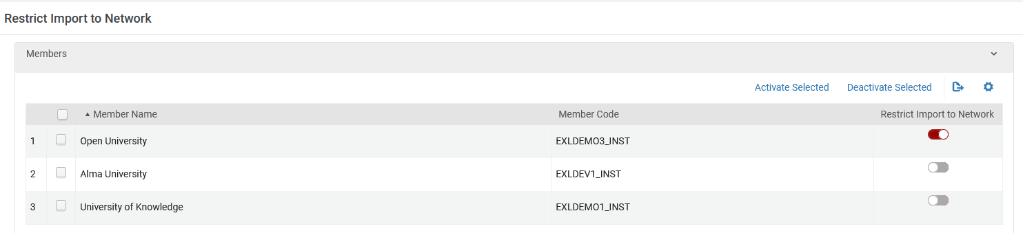
Manually adding a portfolio/physical item/digital representation
In the current setup: Network Zone member institution “Open University” is defined as restricted to import to the Network Zone, but in the Member Institution has DEFAULT_NETWORK defined for parameter central_record_management:
Network Zone
Member Institution Open University

Slide 35
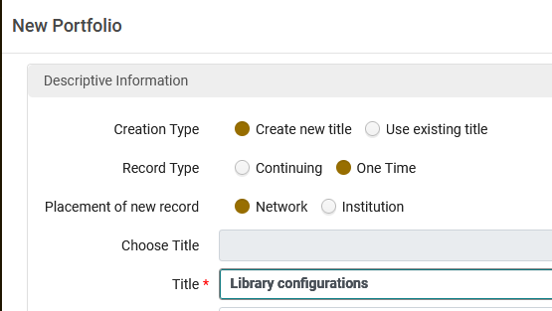
Manually adding a portfolio/physical item/digital representation
In the member institution Open University, for “Placement of new record”, either “Network” or “Institution” can be chosen.
Here we choose “Placement of new record” “Network”

Slide 36
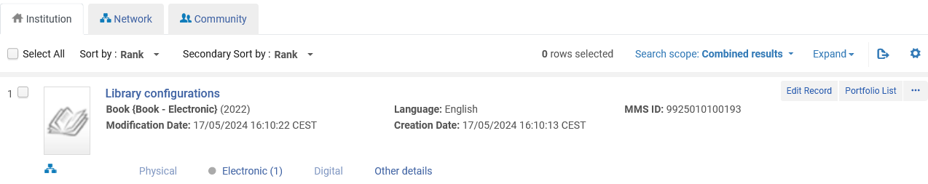
Manually adding a portfolio/physical item/digital representation
The bibliographic record is created in the Network Zone.

Slide 37
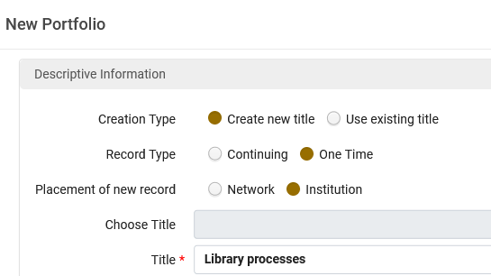
Manually adding a portfolio/physical item/digital representation
In the member institution Open University, for “Placement of new record”, either “Network” or “Institution” can be chosen.
Here we choose “Placement of new record” “Institution”

Slide 38
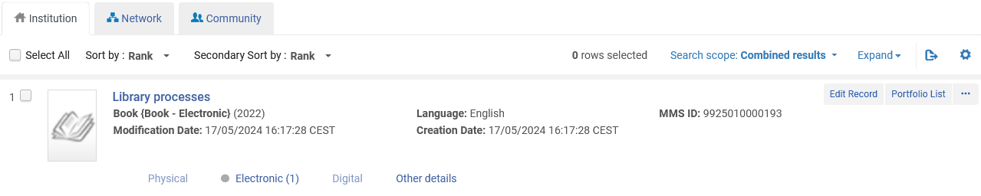
Manually adding a portfolio/physical item/digital representation
The bibliographic record is created in the Institution.

Slide 39
Manually adding a portfolio/physical item/digital representation
When ENFORCE_NETWORK is used in the Member Institution the bibliographic record will automatically get created in the Network Zone when the bibliographic record is created from “Resources > Create Inventory”.
In University of Knowledge ENFORCE_NETWORK is defined for parameter central_record_management

Slide 40
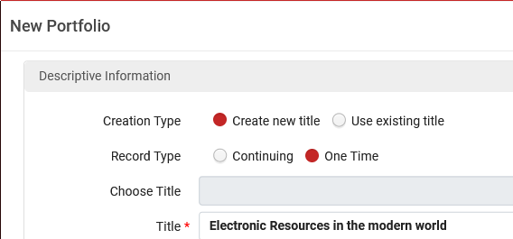
Manually adding a portfolio/physical item/digital representation
In the member institution University of Knowledge, there is no option “Placement of new record” when doing “Resources > Create Inventory”

Slide 41
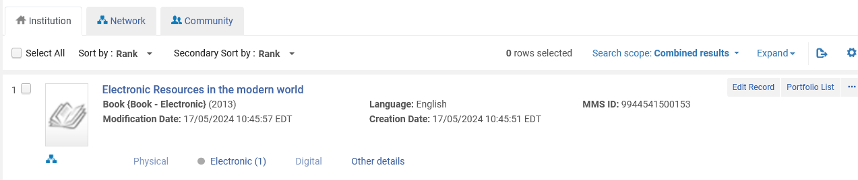
Manually adding a portfolio/physical item/digital representation
The record is automatically created in the Network Zone

